Slide 1
MOVIE BOOKING APP
BY
KRIUTHIKA S

Slide 2
PROBLEM STATEMENT
Movie Booking App is an application that allows the users to register and login and search movies released. User can book the tickets for the movies they wish for. Admin shall view the tickets booked and update the pending tickets available to the system

Slide 3
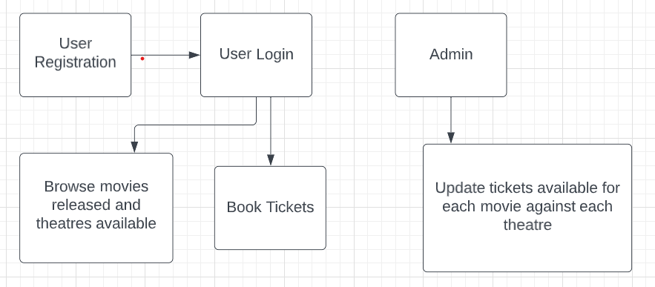
PROPOSED MOVIE BOOKING APP
  UI needs improvisation and modification as per given use case.

Slide 4
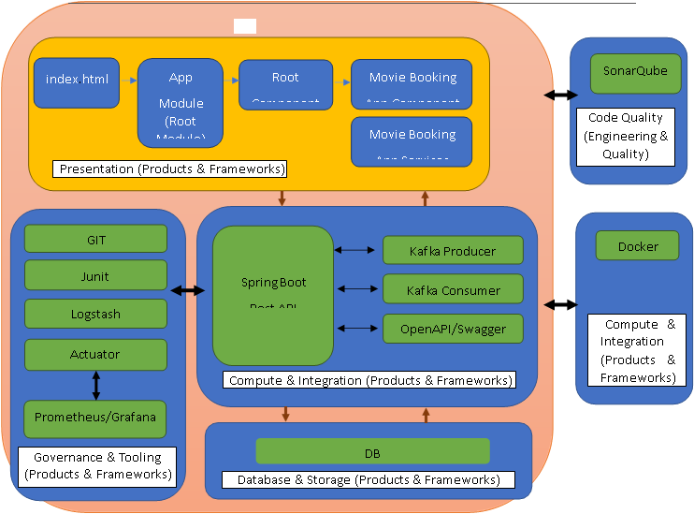
APPLICATION ARCHITECTURE

Slide 5
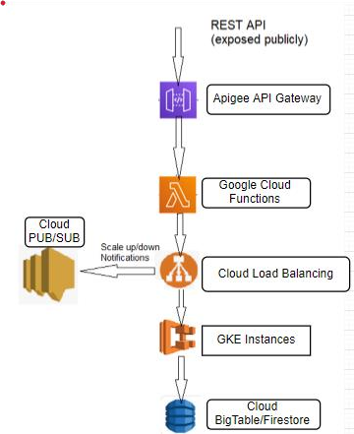
CLOUD ARCHITECTURE

Slide 6
TOOL CHAIN
Competency | Skill | Skill Detail
Engineering Mindset | Networking and Content Delivery
 | Ways of Working
 | Consulting Mindset
 | DevOps
Programming Languages | Application Language | Java
Products & Frameworks | Presentation | Angular
 |  | Karma & Jasmine
 | Compute & Integration | Spring Boot
 |  | Kafka/Kube MQ/Active MQ/RabbitMQ
 |  | Docker
 | Database & Storage | MongoDB/Cassandra/Redis
 | Governance & Tooling | Git
 |  | Maven
 |  | Junit
 |  | Mockito

Slide 7
 |  | Logstash
 |  | Prometheus & Grafana
Engineering Quality | Code Quality | Sonar Cube
Platform | Cloud Tools | Cloud Compute Engine
 |  | Cloud Kubernetes Engine
 |  | Cloud Storage / for Firebase
 |  | Google Cloud Functions
 |  | Cloud Deployment Manager
 |  | Apigee API Platform
 |  | Cloud Load Balancing
 |  | Cloud PUB/SUB

Slide 8
DEBUGGING & TROUBLESHOOTING
Generate bug report & error logs - Report must be linked with final deliverables which should also suggest the resolution for the encountered bugs and errors.

Slide 9
Conclusion
Movie booking app backend was successfully completed. Front end will be continued.

